Slide 1
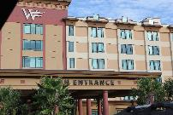
Active Shooter and Hostile Events (ASHE) West Florida Hospital Training

Slide 2
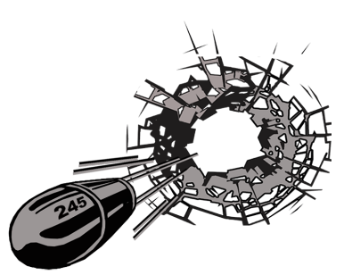
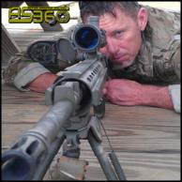
Kenneth Worley CEO / OWNER Active shooter 360 KWORLEY@activeshooter360.com
Active Shooter and Hostile Events (ASHE) West Florida Hospital Training
SWAT Medic Since 2000
Active Shooter Instructor
Workplace Violence Instructor
Paramedic Certified 20+ Years
Flight Medic

Slide 3
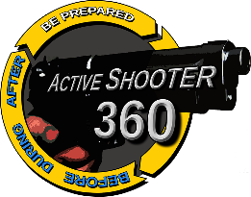
AS360 Company overview:
AS360 is a team of individuals with a unique skill set to help you and your staff prepare for and respond to worst case events.
Preparedness Assessments
Vulnerability Assessments
Response Plan Development
Operating Procedure Review
On-Site Staff Training
Custom Program Development
Incident Response Analysis
After Action Review
Training Exercise Development
Simulator Based Exercise Training
On-Line Programs
Readiness Equipment

Slide 4
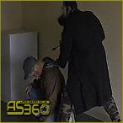
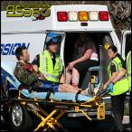
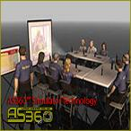
Program overview:
PROGRAM INTRODUCTION
Module One: Battalion Chief Ryan Christen
ASHE Evolution and Brief History
ASHE Response Changes
ASHE Preparedness Needs
Module Two: Sergeant DJ Foley
Situational Awareness
AS360™ 3Gs Response Model
The Terrorist
Module Three: Dr. Hank Christen
Patriot’s Day Bombing
Health Care Facilities: Lessons Learned
Crisis Management and Decision Making

Slide 5
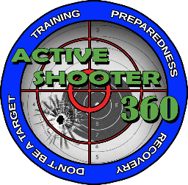
Active Shooter and Hostile Events (ASHE) West Florida Hospital
Module One

Slide 6
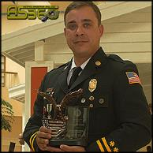
Battalion Chief Ryan Christen Active shooter 360 Rchristen@activeshooter360.com
Active Shooter and Hostile Events (ASHE) MODULE ONE: ASHE History and Evolution
Masters in Public Administration
Department of Homeland Security - HSEEP
Interactive Active Shooter Simulator Developer
Exercise Director/Chief of Planning Multiple Active Shooter Exercises
Contributing Author: ICS for EMS - Active Shooter Response

Slide 7
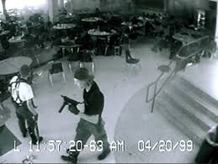
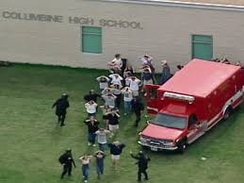
Active shooter History:
Columbine: A wake up call to America
April 20th, 1999
Two assailants
13 Killed and 20 Injured
Multiple explosive devices deployed by attackers
Responders also targeted
Shooters took their own lives
SWAT teams entered the school 47 minutes after the shootings started.
Five hours passed before law enforcement declared the school under control.

Slide 8
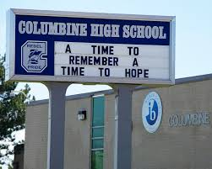
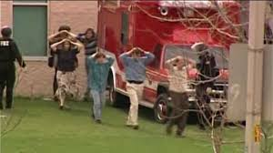
Active shooter History:
Columbine: Critical lessons learned
Motivations were not the motives of “traditional” criminals.
ALL communities are vulnerable.
“Contain and negotiate” was not appropriate as a tactic.
A much faster response was needed.
Those under attack may need to abandon “compliance” and “engage” assailants.
Comprehensive preparedness must be practiced.
Notes:
LE community studied Columbine for years to determine best practice response for new “active shooter” threat.
LE Community realizing the threat is dynamic and policies must be as well.
LE been preparing and adjusting for years. Civilian industry just now starting to recognize this is not just a “LE issue”

Slide 9
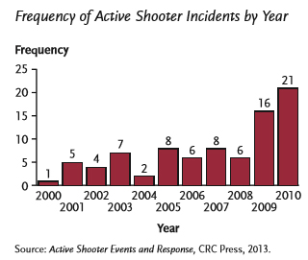
Active shooter History:
Other High-Profile Active Shooter Incidents
(Since Columbine)
Active Shooter events are becoming increasingly more common!
Sandy Hook
Aurora, CO
San Bernardino, CA
Charleston, S.C.
Orlando, FL
DISCUSSION:
Other high-profile active shooter events?
Notes:
Open discussion of other high-profile events.
How would our community manage a response with the resources available?
What would be some short-term and long-term impacts of a similar event at your facility?

Slide 10
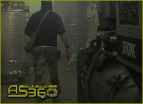
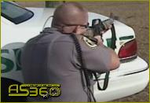
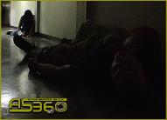
Active shooter History:
What makes an Active Shooter event different from “common” criminal violence?
Escape from the police is usually not a priority.
Attacker Motivation varies tremendously.
Attackers are bent on mass indiscriminate violence.
Active shooters often have made detailed plans for the attack.
Intent on killing as fast as possible.
Notes:
Escape - Most active shooters have not attempted to hide their identity.
Motivation - There is no clear criminal profile. Motivations are not the motives of “traditional” criminals.
Violence -Peaceful resolution is highly unlikely.
Plans - have conducted research and recon. May be better equipped than police.
Killing – can be random, indiscriminate, focused on inflicting maximum damage in shortest time
NO LIST IS COMPREHENSIVE - EACH EVENT VARIES SIGNIFICANTLY

Slide 11
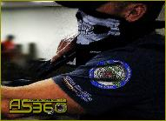
Active shooter History:
How has the response changed?
Early efforts must be driven at engaging and stopping the attacker.
LE – Officers are trained to make solo entries.
LE – Victims may be ignored in pursuit of attacker.
FD / EMS – Responders may enter into “warm zones” to extract injured.
FD / EMS – Equipped with ballistic protection and trained in tactical maneuvers.

Slide 12
ASHE History and Evolution:
Active Shooter is no longer the only threat:
The ASHE term is a more comprehensive identifier of the modern threat.
Attackers are using diverse methods to implement harm and conduct attacks.
ACTIVE SHOOTER HOSTILE
EVENT

Slide 13
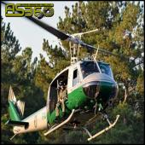
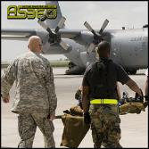
What is ashe:
Active Shooter Hostile Event (ASHE):
Active Shooter
Mass Stabbings
Vehicle Born Attacks
Ambushes / Snipers
Bombings
Mass Disruption
Chemical
ASHE does NOT mean “Mass Fatality.”
ASHE can be simple, yet highly damaging.

Slide 14
What is ashe:
Notable (non-firearm) ASHE incidents:
August 5th, 2015 Nashville Theater Attack 3 Injured by attacker carrying a hatchet, pepper spray, and pellet gun.
January 9th, 2016 Vancouver - Pepper Spray Attack 15 people injured after crowd of 100 attacked with pepper spray. Attack followed by chaos and panic.
November 28th, 2016 Columbus, OH. – Vehicle and Stabbing Attack 11 people injured in vehicle and knife attack at OSU, the country’s third-largest campus by population. Attack triggered massive response and a shelter-in-place order.
Notes:
Discussion: Other (non-firearm) attack examples?
How would a simple pepper spray event impact a hospital?
How would an ASHE (non-firearm) event impact a hospital?

Slide 15
ASHE Preparedness
An evolving threat requires an evolving preparedness model:
ASHE annual training
ASHE annual policy analysis and review
ASHE training exercises
ASHE vulnerability assessments
How does this compare to other threat training: Fire, Hurricanes, Etc.?

Slide 16
ASHE Preparedness
Surviving an ASHE incident requires a change in mindset:
Even with comprehensive planning regular training is essential.
ASHE assailants are not “common” criminals. To be prepared we must train and understand the need to shift our mindset:
Stopping an ASHE incident may require aggressive action from the victims!

Slide 17
AS360 – Okaloosa County Training

Slide 18
AS360 – Okaloosa County Training
WJHG Panama City News Story:
http://www.wjhg.com/content/news/First-on-scene-make-all-the-difference-Okaloosa-County-active-shooter-drill-401784516.html

Slide 19
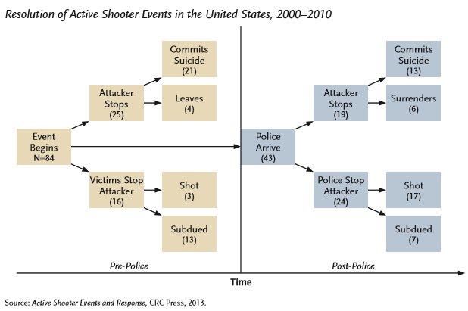
ASHE Preparedness
Surviving an ASHE incident requires a change in mindset:
Notes:
A significant number of events (nearly 40% of pre- LE arrival) were stopped by civilian action. That is, those being attacked fighting back.
This type of action requires an acknowledged change in attitude, training, and preparedness before an event occurs.

Slide 20
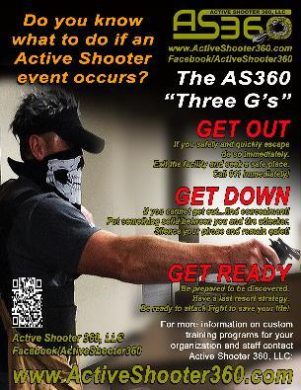
ASHE Preparedness
What do we do if an event occurs here?
Active Shooter 360: The 3Gs
Get out…
Get down…
Get ready!

Slide 21
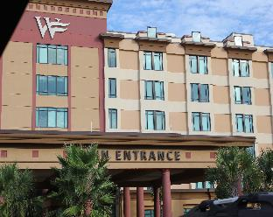
ASHE Preparedness
What are specific medical facility benefits of
Comprehensive ASHE preparedness?
Compliance
Continuity of Operations
Resiliency
Faster Recovery
Managed long-term impacts
Notes:
Compliance – HIPPA, JCO and OSHA

Slide 22
Battalion Chief Ryan Christen Active shooter 360 Rchristen@activeshooter360.com
Active Shooter and Hostile Events (ASHE) Module One
Questions and Discussion

Slide 23
Active Shooter and Hostile Events (ASHE) West Florida Hospital
Module Two

Slide 24
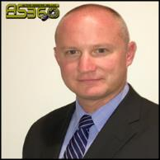
Sergeant DJ Folley Active shooter 360 DFolley@activeshooter360.com
Active Shooter and Hostile Events (ASHE) Module Two: ASHE Response
Advanced Technical Services/Video Surveillance Operations
Homicide Investigation and Crime Scene Management Training
Special Response Team (SWAT)
Investigator Multi Agency Drug Task Force
Bachelor of Science, Criminal Justice with minor in Psychology

Slide 25
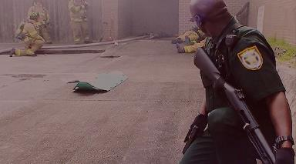
Module Two Overview:
Training Topics
Situational Awareness
3G’s
Get out…
Get down..
Get ready…
The “OODA LOOP”
The Terrorist
Law Enforcement’s Response to Active Shooters

Slide 26
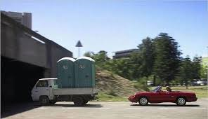
Situational Awareness:
What is Situational Awareness?

Slide 27
Situational Awareness:
Hospital Shooting Video Link:
http://www.clickorlando.com/news/newly-released-surveillance-video-shows-the-lead-up-to-july-hospital-shooting

Slide 28
Situational Awareness:
Know your environment
Structure
Blueprints
Walkthroughs
Entrances / Exits
Fire Alarms
Phone Systems
What is normal and what is not normal

Slide 29
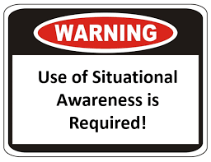
Situational Awareness:
Get to know your people
Identify employee problems
Learn
Habits
Home life
History
Goals
Accurate and consistent documentation

Slide 30
Situational Awareness:
Practice a state of heightened awareness!

Slide 31
AS360 – The 3 Gs
What do we do if an event occurs here?
Active Shooter 360: The 3Gs
Get out…
Get down…
Get ready!

Slide 32
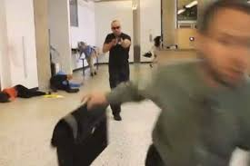
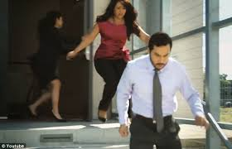
Situational Awareness:
GET OUT…
Do not hesitate
Easiest route
Avoid dangers
Take others with you
Leave items that may slow you down

Slide 33
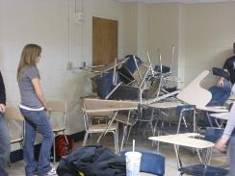
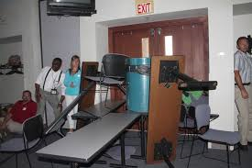
Situational Awareness:
GET DOWN…
Isolation from the threat
Recruit others if possible – Strength in numbers
Close and lock doors
Barricade
Turn off lights
Mute phones

Slide 34
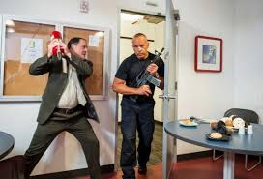
Situational Awareness:
GET READY…
Mentally prepare
Arm yourself
Make a plan
Attack with swift decisiveness

Slide 35
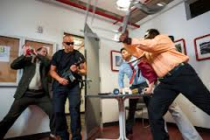
Situational Awareness:
GET READY…
Utilize the tools available to you
Surprise
Darkness
Silence
Maneuvers

Slide 36
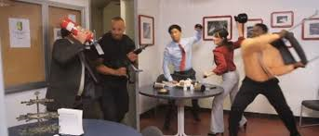
Situational Awareness:
GET READY…
Continue your attack until the threat is neutralized
“Fight or Flight”

Slide 37
Situational Awareness:
GET READY…
The OODA Loop
Observe, Orient, Decide and Act
Decision cycle developed by military strategist and United States Air Force Colonel John Boyd in 1961

Slide 38
The ASHE Terrorist:
What is a Terrorist?

Slide 39
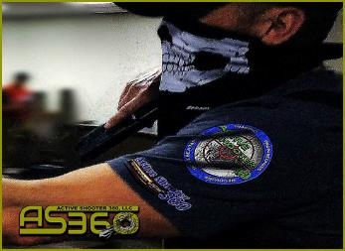
The ASHE Terrorist:
The Modus Operandi of a terrorist
Extremists
Shock
Violent
Personal or political
Goal is to cause maximum havoc

Slide 40
The ASHE Terrorist:
Attacks typically ended upon confrontation with law enforcement.
Most end in suicide or suicide by cop.
Most active shooter situations end with 10-15 minutes

Slide 41
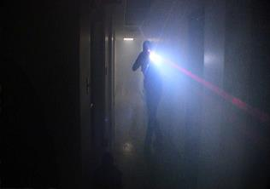
ASHE – Law Enforcement Response
Law Enforcement Objectives:
Arrive
Rapidly gather intel if possible
What
Where
Who
Access points
Keys
Etc.
Immediately locate and neutralize the threat(s)
Secure the location
Render aid

Slide 42
ASHE – Law Enforcement Response
Considerations
Responders have 10-15 minutes to end the carnage.
May be the 1st person on scene that seeks out and engages the threat.
Will pass the dead or injured

Slide 43
ASHE – RESPONSE Scenarios
What would you do?

Slide 44
Sergeant DJ Folley Active shooter 360 DFolley@activeshooter360.com
Active Shooter and Hostile Events (ASHE) Module Two
Questions and Discussion

Slide 45
Active Shooter and Hostile Events (ASHE) West Florida Hospital
Module Three

Slide 46
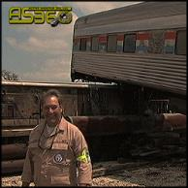
Dr. Hank Christen Active shooter 360 hchristen@activeshooter360.com
Active Shooter and Hostile Events (ASHE) Hospital hard-earned lessons
Doctor of Education - UWF
Doctoral Specialty in Human Performance Technology
Analysis Team Member - Boston Marathon Attack
Former Unit Commander FL-1 DMAT
Federal Disaster Team Response to WTC
Notes:
Boston has more trauma centers than many States have
5 Adult Level 1 Trauma Centers
3 Pedi Level 1 Trauma Centers
Conference of Boston Teaching Hospitals- consortium of 14 Boston Area hospitals:
Emergency management committee– surge, MCI, disaster planning
EMS committee–
-ambulance diversion ended on Jan 1, 2009 after a trial in Boston

Slide 47
Mass General First Responders on Boston Marathon Bombing

Slide 48
AS360 – Okaloosa County Training
Mass General First Responders on Boston Marathon Bombing Video Link: https://www.youtube.com/watch?v=csSNp3oAmZU

Slide 49
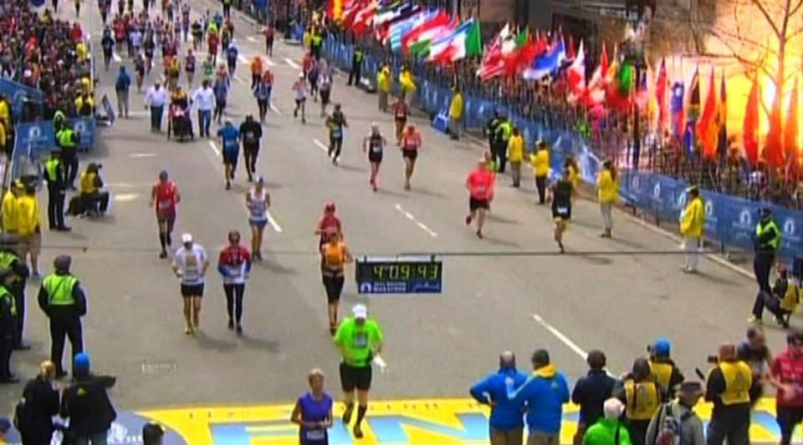
14:50 - A powerful explosion occurs close to the finish line at Copley Square, 673 Boylston St.
Notes:
Note the time 4:09: 43-- picture a few slides later shows our crews on scene 43 seconds later

Slide 50
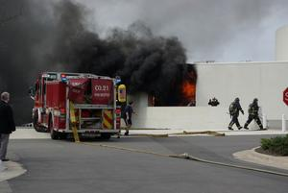
14:55 - Reported Explosion at the John F. Kennedy Library, 5 miles away in Dorchester
Notes:
The fire turned out to be an electrical transformer fire, but given the location (JFK Library) and timing– initial thoughts were continued attacks

Slide 51
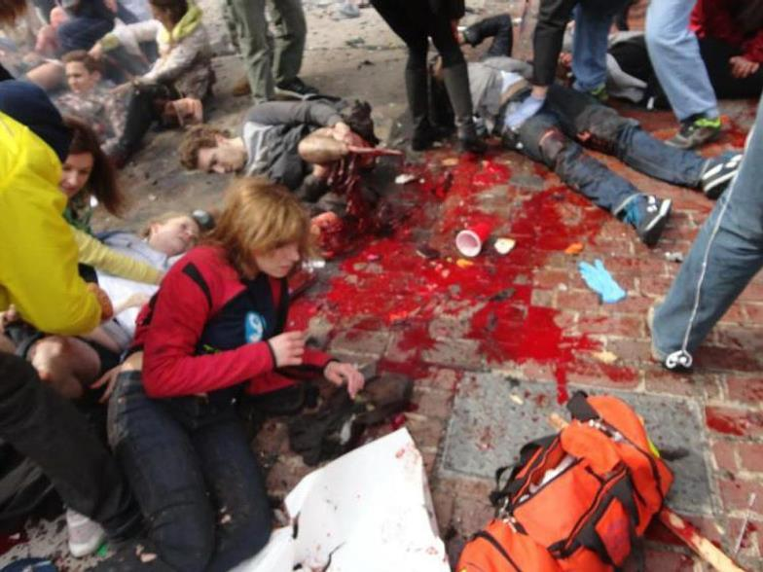
Notes:
Bystanders already applying direct pressure
EMS first aid bags on scene.

Slide 52
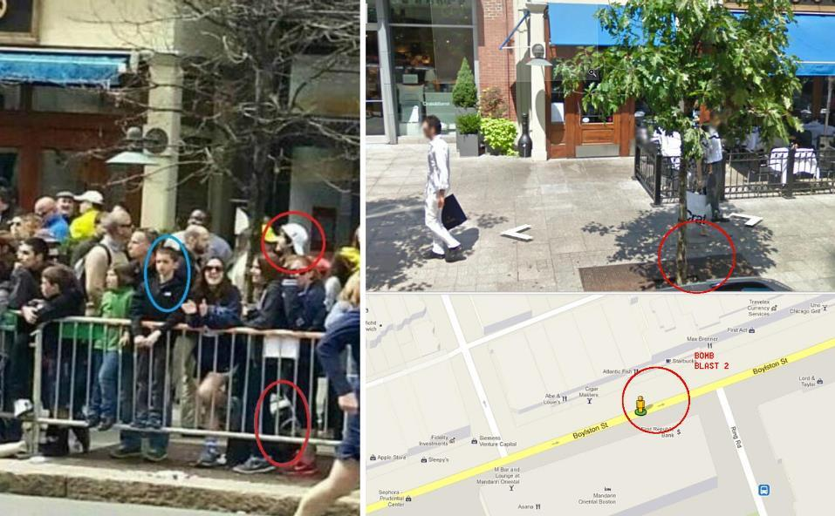
The last minutes of Mark’s life

Slide 53
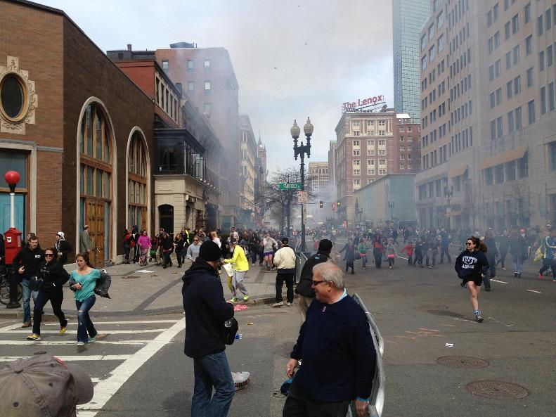

Slide 54
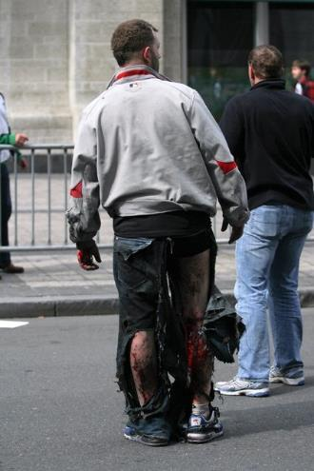
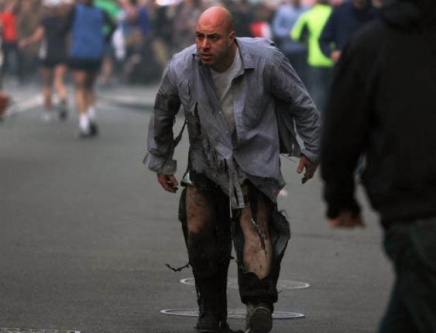
What does a law enforcement
Officer see here?

Slide 55
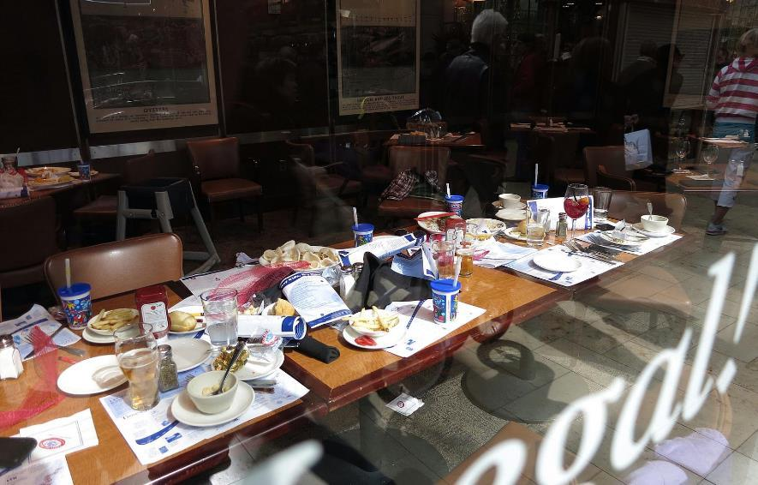

Slide 56
Patient Identification Nightmare
Martin Richard
8 Y/O
Krystle Campbell
29 Y/O
Lingzi Lu
23 Y/O

Slide 57
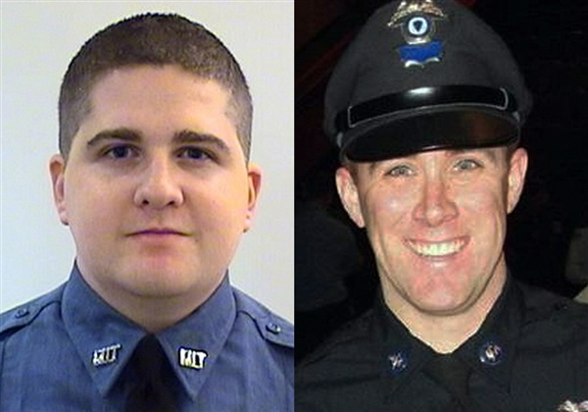
Donohue got lucky at Mt. Auburn
Sean Collier
26 Y/O
Richard Donohue Jr.
33 Y/O
Notes:
Boston EMS and the response in general widely hailed as a success.
Need to remember the three killed on scene. Dozens were maimed or otherwise life changing injuries. Later that week an MIT Police officer was executed in his cruiser. This lead to a shoot out and one terrorist shot and run over. The whole area was then put on an unprecedented lock down, and second suspect ultimately captured.
So “success” may not be the best term for the response, but we certainly made the best out of a terrible situation.

Slide 58
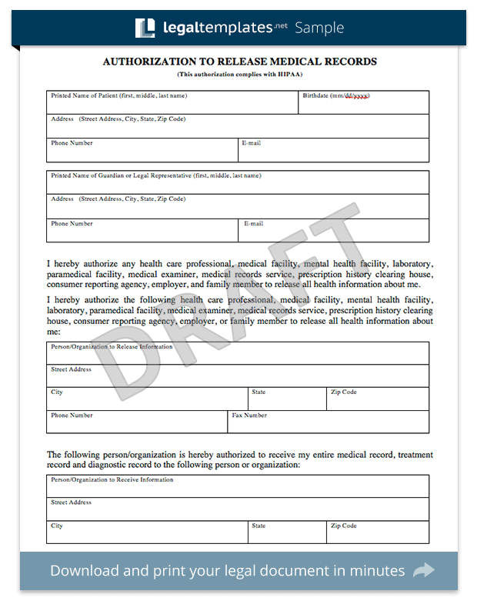
“We hit the HIPAA wall.”

Slide 59
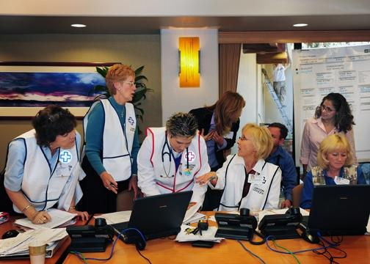
HICS Hospital Incident Command System

Slide 60
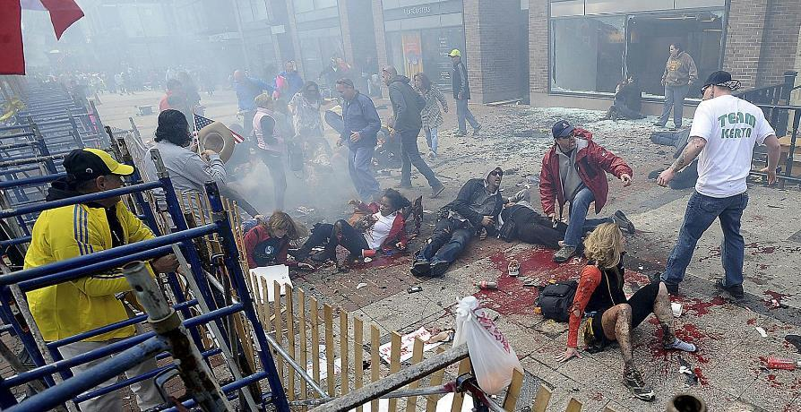
Tourniquets are back

Slide 61
Unsung Heroes – Hospital Social Services
Family Reunification
Link survivors to community services
Emotional support to staff and families
Opened their hearts and their homes

Slide 62
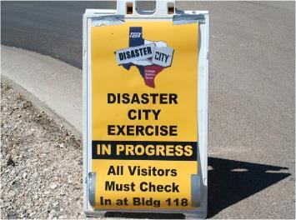
Exercise – Exercise – Exercise
Homeland Security Exercise and Evaluation Program (HSEEP)
In story after story, hospitals
tout the benefits of realistic
exercises.
Seminars
Workshops
Drills
Functional exercises
Tabletops
Full scale exercises

Slide 63
Decision-Making Tabletop

Slide 64
Hospitals admit witnesses
and collect evidence

Slide 65
Long-term recovery for patients and staff
Recovery/rehab may take yrs.
You may lose some staff
Don’t forget the cleaners

Slide 66
Red Within Red Triage

Slide 67
Lockdown or “Restricted Entry”

Slide 68
Bomb scares come out of the woodwork!

Slide 69
Black Swan Crisis Leadership
Big Things
Bad Outcomes
Little Information
No Time
Traditional decision-making fails!

Slide 70
Dynamic Resilience Model See one, Do one, Be one

Slide 71
Dr. Hank Christen Active shooter 360 hchristen@activeshooter360.com
Active Shooter and Hostile Events (ASHE) Module Three
Questions and Discussion

Slide 72
Kenneth Worley CEO / OWNER Active shooter 360 KWORLEY@activeshooter360.com Battalion Chief Ryan Christen Chief Operations Officer Active shooter 360 Rchristen@activeshooter360.com
Active Shooter and Hostile Events (ASHE) West Florida Hospital Training
Sergeant DJ Folley Curriculum Development / Special Technical Advisor Active shooter 360 DFolley@activeshooter360.com Dr. Hank Christen Human Performance Technology Active shooter 360 hchristen@activeshooter360.com

